Slide 1



PeeK: A Prune-Centric Approach for K Shortest Path Computation
Wang Feng, Shiyang Chen, Hang Liu, Yuede Ji
1
Notes:
Thank you for the introduction.
Good morning everyone. Today, I'm glad to share our works on PeeK: A Prune-Centric Approach for K Shortest Path Computation.
% Slow down
% Stop for a while (less than one second) before switching to the next slide.

Slide 2

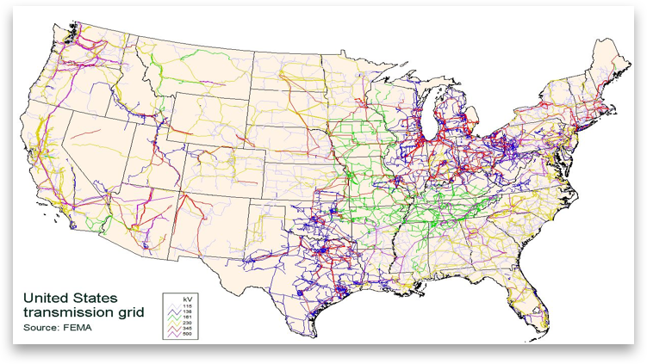
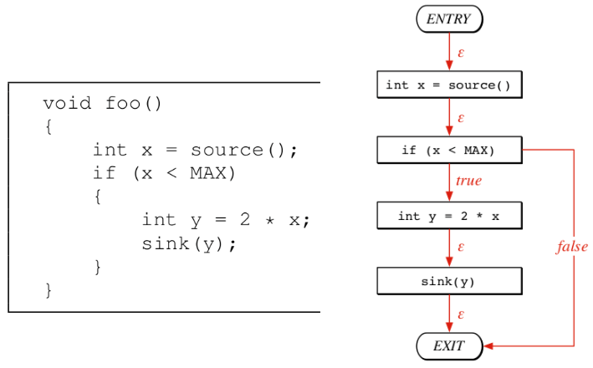

Graph is Everywhere
Notes:
Graph is made up of vertex and edge. It is a natural representation for many real world applications.
For example, in the social network, every person is a vertex, the connection between two persons is an edge. Together, they form a social network graph. In code analysis, taking every statement as a vertex, the control flows between them as an edge, you can get a control flow graph.
Graphs can also be found in many other applications, such as map and internet communication networks.
Another example is the Internet communication network, every IP address is a vertex, the network connection between two IP addresses is an edge. Together, they form the network communication graph.

Slide 3
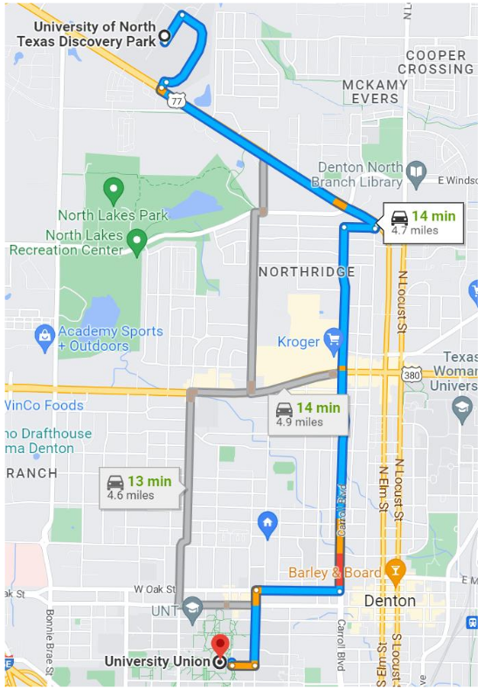
Top-K Shortest Path (KSP)
K shortest path (KSP) algorithm aims to find the top-K shortest paths from the source vertex s to the target vertex t.

Slide 4
Motivation
Key observation: Top-K shortest paths only cover an extremely small portion of the original graph, even for very large K values.
Example
GAP-twitter with 61.6M vertices and 1.5B edges.

Slide 5
Overview of PeeK
PeeK
Step 1: K upper bound pruning.
Step 2: Adaptive graph compaction.
Step 3: KSP computation.

Slide 6
Contribution #1: K Upper Bound Pruning
K upper bound pruning
Step 1: SSSP computation based on source vertex.
Step 2: SSSP computation based on target vertex.
Step 3: Sum up two distances of each node based on two SSSP trees to find out K upper bound.
Notes:
SSSP means Single source shortest path

Slide 7
Contribution #1: K Upper Bound Pruning
Benefits:
Pruning 98.4% vertices and 97.7% edges on average for k equaling to 8.
Pruning 97.7% vertices and 96.6% edges on average for k equaling to 128.
K = 8
K = 128

Slide 8
Contribution #2: Adaptive Graph Compaction
Unique graph compaction patterns
Only involving vertex and edges deletion, not insertion.
The graph is updated three times, i.e., two SSSPs and K upper bound pruning.
Two compaction strategies
Edge swap-based compaction.
Graph regeneration-based compaction.

Slide 9
Contribution #2: Adaptive Graph Compaction
Graph compactions comparison:
Status array-based (baseline)
Edge swap-based
Graph regeneration-based
Notes:
Twitter graph with K=8, make sure required vertices and edges for K=8 are kept, then randomly delete the other edges

Slide 10
Contribution #3: Parallel PeeK
Data parallel
Task parallel
Shared-memory PeeK
Distributed PeeK

Slide 11
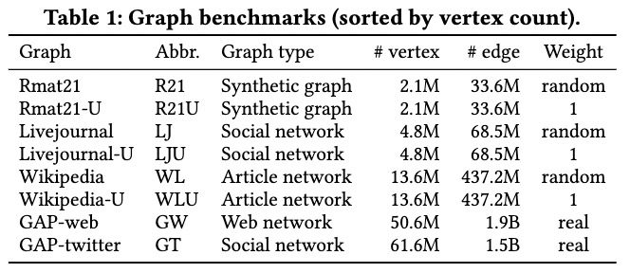
Experiment
Experiment setting

Slide 12
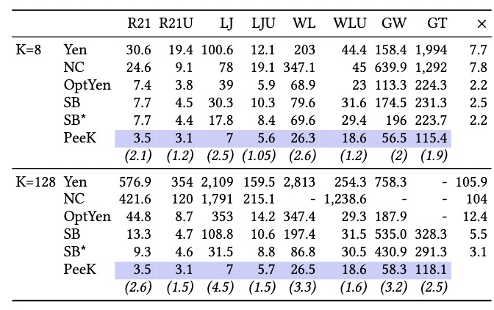
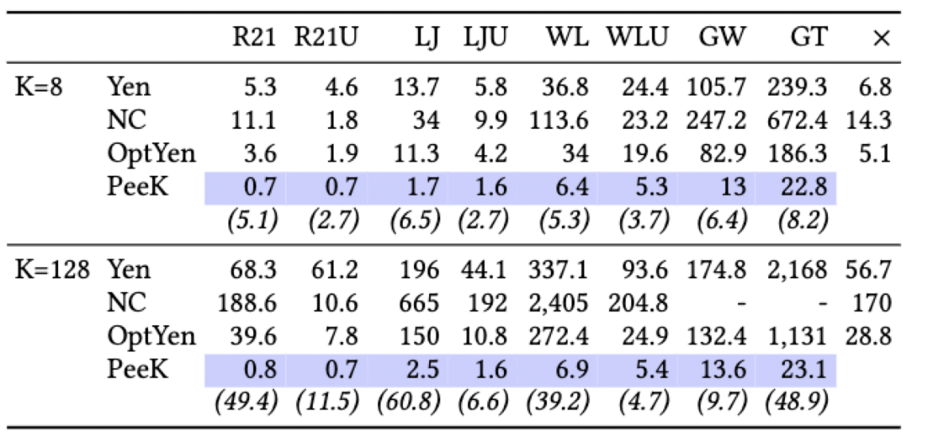
Performance Comparison
PeeK outperforms all the other algorithms for both parallel and serial executions.
PeeK achieves more speedup for larger K values.
Parallel runtime (s)
Serial runtime (s)

Slide 13
Technique Benefits
Two techniques are tested against baseline (OptYen).
K upper bound pruning technique contributes more than adaptive graph compaction.

Slide 14
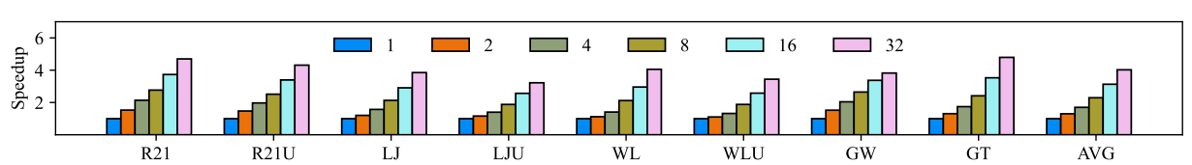
Shared-Memory Scalability
PeeK shows a stable speedup increase when the thread count also increases.
PeeK with 32 threads achieves 4* speedup on average, and highest speedup is 4.8* for graph GT.

Slide 15
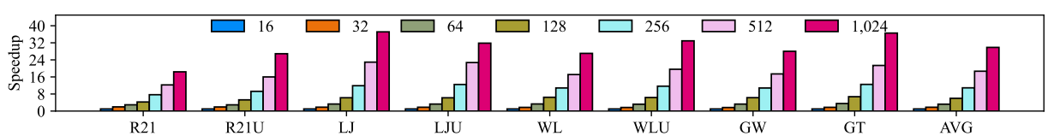
Distributed Scalability
The performance of PeeK stably improves with the increase of computing nodes and cores.

Slide 16
Key Takeaway
K upper bound pruning is the key contribution, which impacts a lot to KSP computation.
PeeK can integrate with existing KSP algorithms to boost their performance.

Slide 17

Acknowledgement
Thank the anonymous reviewers for their valuable suggestions.
Express our grateful thanks to the authors of OptYen for sharing the source code with us.
It is not the final version.
Source code
https://github.com/SC-Lab-Go/PeeK

